Slide 1

rofiling nd esearching
IMSS by ntroducing a urriculum- ens on ight-grade cience
P
A
R
T
I
C
L
E
S
Image: Colourbox
Stephan Daus
Notes:
I would like to thank IEA for the Bruce H. Choppin award,
And for challenging me to summarizing in 15 minutes 4 years of research that has resulted in 4 separate studies.
Please beware that I have not followed the typical format of presentations at scientific conferences.
The first issue that has motivated this research project is the lack of exploration and exploitation of the smaller particles of the TIMSS assessment framework. Hence the abbreviation of the project title.

Slide 2



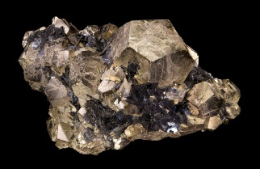




Issues
Innovations
Insights
Improvements
TIMSS 2015 8th grade science framework
4 domains
Biology
Chemistry
Earth Science
Physics
Under-
explored
18 topics
Chemical Changes
Composition of Matter
Properties of Matter
Item #1
Item #...
Item #12
Notes:
Specifically, I am referring to the content division of the TIMSS framework into 18 topics, as well as the more than 200 items in the science test.
In addition, the teachers respond to about 22 questions regarding what of the topics in the TIMSS assessment they have taught.
Despite that the assessment is not constructed for this purpose, it is worth exploring whether it is possible to produce country profiles that are a bit more fine-grained than the standard country rankings as seen in the international reports.
By the way, everything I present regarding the science test will be applicable for mathematics as well.

Slide 3
Issues
Innovations
Insights
Improvements
“TIMSS studies the effectiveness of curriculum and instruction in relation to student achievement […]” (Mullis & Martin, 2005, p. 13)
If TIMSS is to be of maximum use to a country’s educators, TIMSS should be linked to the curriculum being analysed.
Insufficient to accept such an assumption; should be verified.
Notes:
A second issue that motivated this research project is the realization that TIMSS asks:
What has a student learned in school math and science by grade 4, 8 or 12?
Hence, we can classify TIMSS as a curriculum-oriented assessment. You might wonder, what would the alternative be? Well, an assessment that is literacy-oriented or something more similar to a general ability test would likely measure a trait that is purely influenced by the child’s intelligence or upbringing alone.
If TIMSS is to be of maximum use to a country’s educators, TIMSS should be linked to the curriculum being analysed.
If TIMSS detects instruction in a participating country, educational processes and inputs can be evaluated with the TIMSS achievement data.
However, it is insufficient to accept such an assumption; should be verified.
Curriculum-sensitivity is one such approach, meaning that we check whether students who were taught the test-contents score better than those who were not taught it.
Yet, this has rarely been investigated (but see: Luyten, 2016; Schmidt et al., 2001)

Slide 4
Articles in PARTICLES
Issues
Innovations
Insights
Improvements
= peer-reviewed
publication
Investigating achievement data:
Investigating content coverage data:
Investigating achievement and content coverage data:
Aggregated analysis:
Fine-grained
analysis:
What are the Norwegian 8th grade’s strengths & weaknesses across content in the TIMSS 2011 science assessment?
What do Norwegian science teachers cover in lower-secondary and do their knowledge predict coverage, w/TIMSS 2015?
Notes:
So we developed a research agenda that primarily focuses on the content side of the science assessment framework in TIMSS,
which we can place in this matrix. Whereas most research has attended to aggregated analyses, we aimed for more fine-grained analyses.
In the first phase we tried to create country profiles, exemplified with Norwegian eighth graders. We wanted to see whether Norwegian pupils are stronger or weaker on some topics compared with other topics and compared with that of the international country average.
Next we aimed to create a similar country profile for what teachers cover in the classroom. In Norway, like in many countries, the national curriculum is not specified for each grade but rather for grade ranges.
We seized the opportunity of TIMSS 2015 when Norway participated with both 8th and 9th graders in the same schools to see what teachers taught in each grade in lower-secondary. And also why they decide to cover a topic or not.

Slide 5

Issues
Innovations
Insights
Improvements
School average
ability
Topic
average difficulty
Residual student «ability»
Student ability
Item difficulty
Residual item «ability»
WITH PROPER STATISTICAL INFERENCES
Test response
Notes:
So how do we do these «fine-grained» analyses?
Rather than starting off with the estimated student achievement scores, we look at the original test responses. A correct response to an item is a «product» of the student’s ability, but also the difficulty of the item.
At times it might also be necessary and useful to consider the fact that students belong to a school and we can thus estimate some average school ability.
We have basically just followed the same idea, but for the items: Items are grouped in topics and domains, and we can therefore estimate the average difficulty within a topic as well.
Rather than just taking a simple mean of the item difficulties we apply sound statistical approaches to ensure that we get precise and accurate estimates.
Please ask me later if you are interested in knowing more about how this is done.

Slide 6
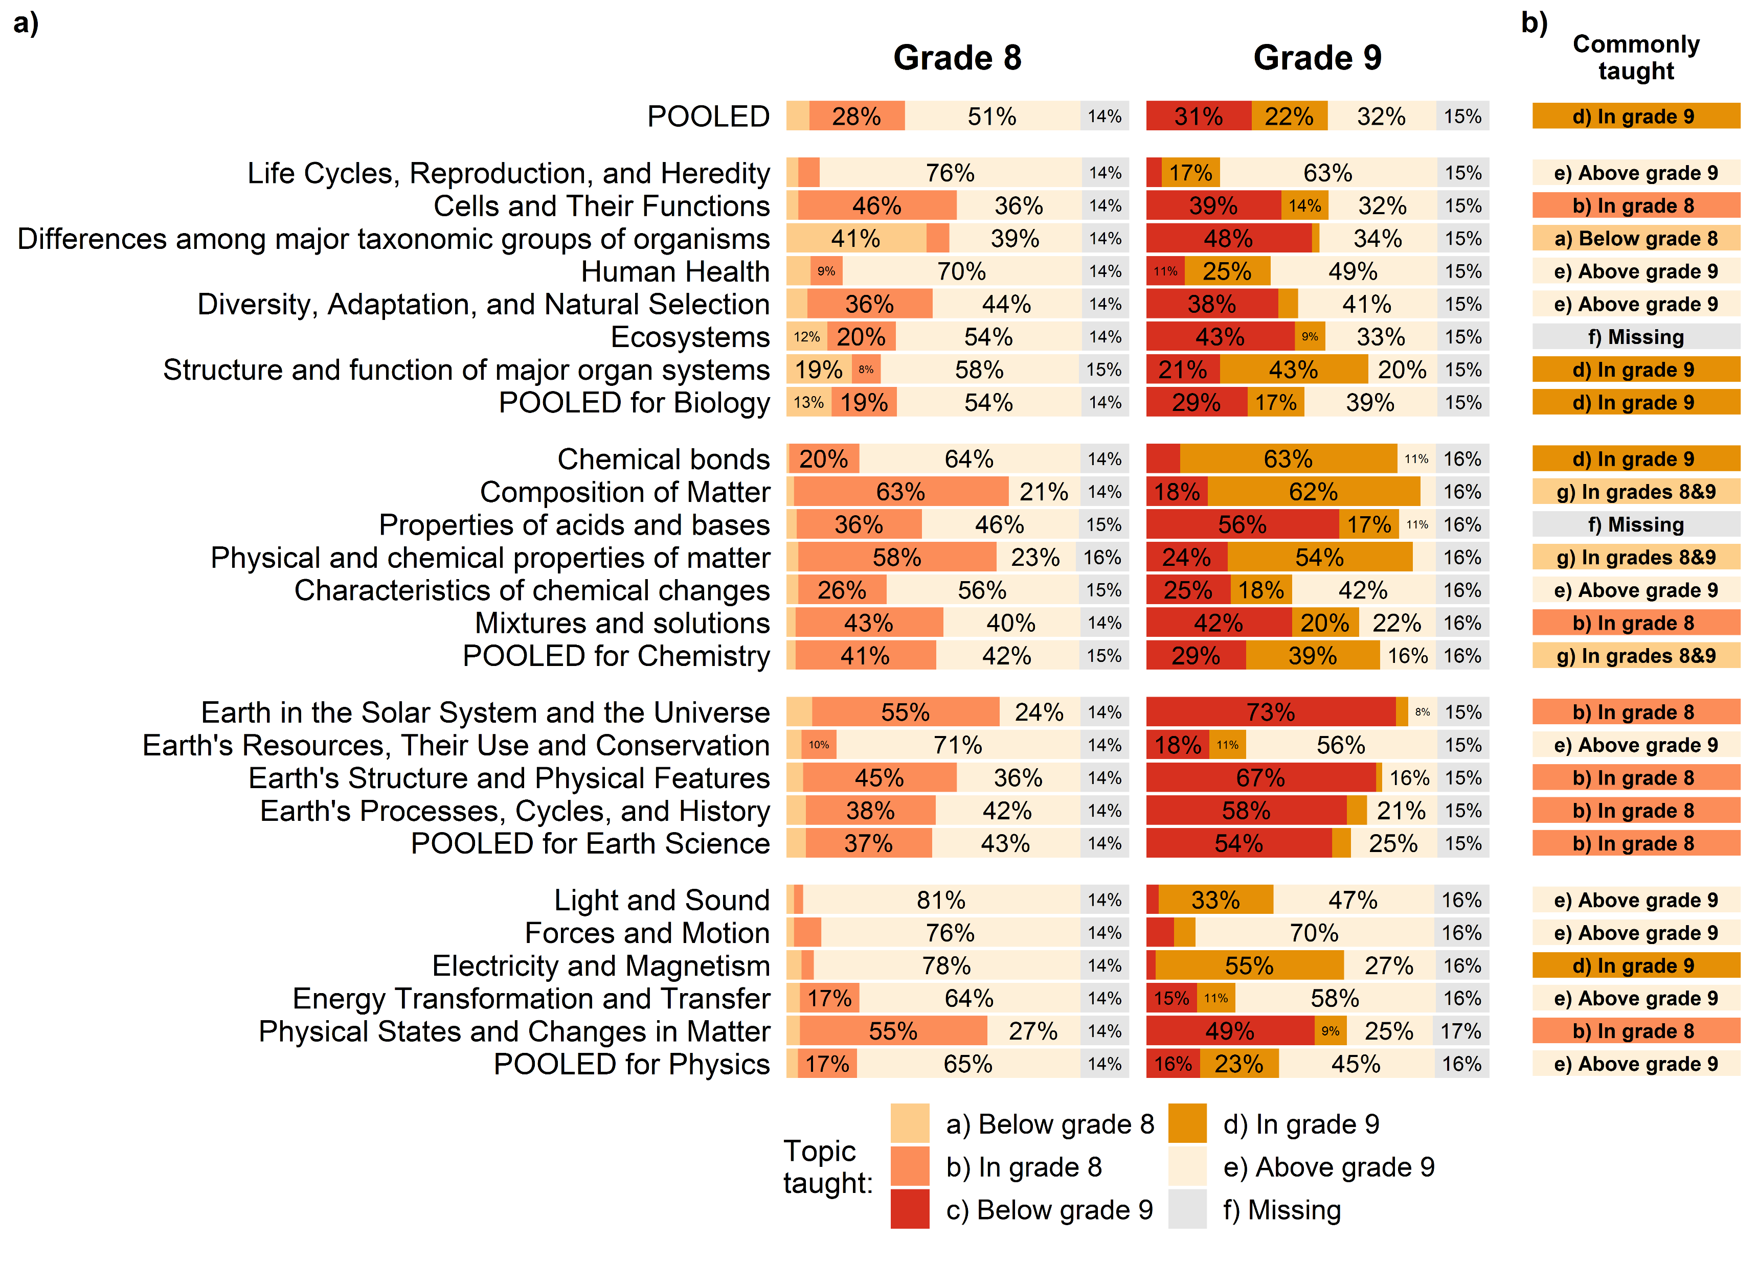
Issues
Innovations
Insights
Improvements
Norwegian 8th graders
× International country average
Solar System and the Universe
Electricity and Magnetism
Notes:
What we get is a nice-looking country-profile for all the topics. Here are two examples from Norway:
8th grade pupils outperform the international average on «the Solar System and the Universe»
and underperform on «electricity» (as defined and measured in TIMSS)
Here we used the international country average as baseline, but it is technically possible to do the same comparison between any two countries.
As for the country profile of teachers’ coverage of the TIMSS topics, we can make something like this.
Here we see that an obvious reason for the findings in the previous example is that the Solar System and the Universe were taught in most grade 8 classrooms, whereas electricity and magnetism were only taught in grade 9 for the majority of classrooms.
Another interesting finding was that teachers’ formal training and competence seem to predict whether they cover a given topic.
For more on this, please see the poster.

Slide 7
Articles in PARTICLES
Issues
Innovations
Insights
Improvements
= peer-reviewed
Investigating achievement data:
Investigating content coverage data:
Investigating achievement and content coverage data:
Aggregated analysis:
How valid are TIMSS content coverage indicators in a Norwegian context?
(master thesis)
How sensitive are the TIMSS 2015 country achievement scores and rankings to differences in content coverage?
Fine-grained
analysis:
What are the Norwegian 8th grade’s strengths & weaknesses across content in the TIMSS 2011 science assessment?
What do Norwegian science teachers cover in lower-secondary and do their knowledge predict coverage, w/TIMSS 2015?
How sensitive are the TIMSS 2015 items to Norwegian teachers’ curriculum coverage across grades, beyond “cognitive maturation”?
Notes:
As you might have noted in the previous examples, I only tried to link with words the relationship between the achievement data and the coverage data.
Is there a statistical relationship between the two? In that case we would have some evidence of TIMSS being sensitive to the curriculum of a country.
In the next phase we investigated whether the country achievement mean scores and ranks change when we account for the different opportunities to learn the science assessment in TIMSS.
The short answer is: No, we did not find a clear and consistent relationship across the countries.
This led to a side-project where my master’s student used think aloud interviews with teachers to investigate the validity of the TIMSS content coverage indicators, and found some minor issues.
Yet, we continued with fine-grained analyses of the relationship between achievement and teachers’ content coverage.
We again used the situation in Norway in TIMSS 2015 with adjacent grades within the same schools to control for the fact that children generally score better on any test, the older they get.

Slide 8
Issues
Innovations
Insights
Improvements
Sensitivity of TIMSS 2015 science items to Norwegian curriculum
  16% are clearly sensitive
  71% are sensitive to cognitive maturation AND/OR curriculum coverage
  Curriculum coverage within a grade contributes to achievement equivalent to a year of schooling
➔ Thus, TIMSS is somewhat sensitive to the Norwegian enacted curriculum
Improved methods
  Fine-grained analyses at response-level
  Use of adjacent-cohorts within the same schools
  Controlling for cognitive maturation
➔ Improving precision (less noise) and accuracy (less bias)
Notes:
This is what we found from this last study.
Sensitivity of TIMSS 2015 science items to Norwegian curriculum
16% are clearly sensitive
71% are sensitive to cognitive maturation AND/OR curriculum coverage
But overall, curriculum coverage within a grade contributes to achievement equivalent to a year of schooling
➔ Thus, TIMSS is somewhat sensitive to the Norwegian enacted curriculum
Moreover, this study shows the usefulness of improved methods compared with prior studies
Fine-grained analyses at response-/item-level
Use of adjacent-cohorts within the same schools ➔ control for prior achievement
Controlling for cognitive maturation
➔ Improving precision (less noise) and accuracy (less bias) of our curriculum-sensitivity analysis

Slide 9
Current design and instruments need improvements
Issues
Innovations
Insights
Improvements
Revisit opportunity to learn instruments used in TIMSS 1995 and reconsider OTL measures
Ensure proper analytical approaches when checking for curriculum-sensitivity
Reintroduce “longitudinal” designs (more often)
Balance needs of international comparisons with national curriculum-specificity
Consider updating assessment framework and its organizing principles to tomorrow’s curriculum reforms
Notes:
Some parts of these studies are limited to the Norwegian context due to the uniqueness of the Norwegian participation in TIMSS 2015.
However, I have raised in my work 5 areas of improvement for these kind of curriculum sensitivity analyses, of which I will briefly mention 2 in the following.

Slide 10
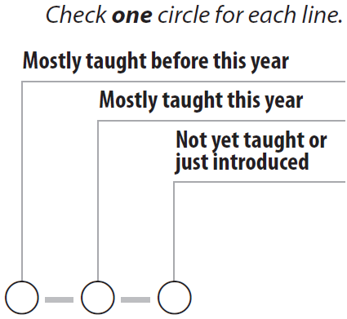
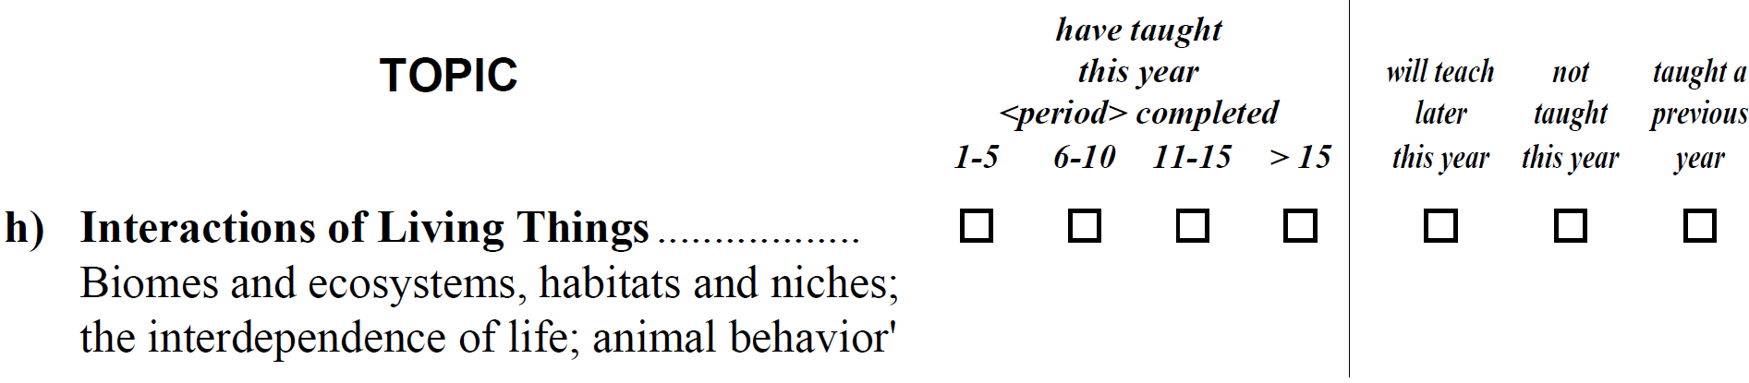
1. More precise classroom OTL variables
Issues
Innovations
Insights
Improvements
TIMSS 2015
Forces and motion……………..………
TIMSS 1995
Notes:
I share Bill Schmidt’s sadness in seeing that today’s questionnaire to the teachers regarding the opportunities students get to learn what is being tested is becoming less prioritized.
Compare the current question with that of TIMSS 1995:
In the past, multiple responses were allowed so we could see whether topics had been taught across multiple grades
and we could see how many lessons were spent on a topic
I realize that we must consider the burden on the teachers.
However, we are narrowing down the measurement of opportunity to learn to such a small aspect of it that it hardly makes any sense anymore.

Slide 11
1. More precise classroom OTL variables
Issues
Innovations
Insights
Improvements
How about instructional quality of the specific content being taught? ⁵
Have successfully taught this year
strongly disagree agree strongly
disagree agree
Forces and motion……………………
⁵ Wang & Goldschmidt, 1999; McDonnell, 1995; Levin, 2009; Wang, 1998
Notes:
My suggestion (avoid burden + more precision, less accuracy):
Downside of mixing content coverage with perhaps teachers’

Slide 12
2. Appropriate secondary analysis methods
Issues
Innovations
Insights
Improvements
Insufficient to have highly detailed variables if not put to use
Acceptable way to summarize OTL variables ⁶
Questionable way to summarize OTL variables
‘Opportunity to learn electricity’
‘Opportunity to learn science’
Time spent on electricity
Textbook space on electricity
Electricity taught last lesson
Coverage of electricity
Coverage of forces and motion
Coverage of light and sound
⁶ See e.g. Schmidt et al., 2001
Notes:
TIMSS collects highly detailed variables, we sometimes lose interesting information if we always and automatically aggregate the data to account for measurement error.
And when we do aggregate variables, which we at times need to, we should keep in mind how we summarize a set of variables that measure some form of opportunity to learn.
I would argue that it is acceptable to summarize different measures of the same topic, in this case the students’ opportunity to learn electricity’.
However, it is perhaps more questionable to summarize variables that measure different topics.
This construct makes a strong assumption that coverage of electricity is correlated with coverage of forces and motion, which is hardly the case in reality. As teachers are limited on time, and need to prioritize what to cover most.

Slide 13
Planned studies
Issues
Innovations
Insights
Improvements
Thanks to IEA for open access data of good quality
a) Longitudinal analysis at country-level and topic/item-level
b) Why weaker OTL-achievement relationship in science than in math?
  Intrinsic issue with science education?
  Too big variety across countries?
  Problematic TIMSS science test items?
  Problematic TIMSS OTL indicators?
And to CEMO/ILS at the University of Oslo
Slides/papers/collaboration:
stephan.daus@nifu.no
Notes:
Do I sound pretentious?

