Slide 1


ICILS 2018
International Results
(Under embargo)
IEA GA-60
6-11 October 2019, Ljubljana, Slovenia
Julian Fraillon

Slide 2
Contents
What is ICILS (who, what and how)?
Student CIL outcomes
Student CT outcomes
The digital divide and student CIL and CT outcomes
Students’ use of ICT
Teachers’ use of ICT
Brief reflections
Computational thinking – beating the test

Slide 3
What is ICILS (who, what and how)?

Slide 4
Who participated in ICILS 2018?
Chile , Denmark , Finland , France , Germany , Italy , Kazakhstan , Korea, Rep. of , Luxembourg , Portugal , Uruguay , United States , Moscow (Russian Federation) , North Rhine-Westphalia (Germany)

Slide 5
refers to an individual’s ability to use computers to investigate, create and communicate in order to participate effectively at home, at school, in the workplace, and in society.

Slide 6
refers to an individual’s ability to recognize aspects of real-world problems which are appropriate for computational formulation and to evaluate and develop algorithmic solutions to those problems so that the solutions could be operationalized with a computer.

Slide 7
ICILS 2018 Instruments
Student test
  CIL Five 30 minute modules (each student completes two)
  CT Two 25 minute test modules (each student completes both)
Student questionnaire
  Background information, computer use in and out of school
Teacher questionnaire
  Background information, computer use in teaching and attitudes towards computer use in teaching
ICT-Coordinator questionnaire
  School resourcing for use of ICT in teaching
Principal questionnaire
  School characteristics and policies for use of ICT in teaching and learning
National Contexts Survey
  Education system characteristics, policies and resourcing relating to CIL and CT education

Slide 8
Student CIL outcomes

Slide 9
Country CIL Averages
Denmark
Korea, Rep. of
Finland
Germany
Portugal
France
Luxembourg
Chile
Uruguay
Kazakhstan
Italy
United States
Moscow (Russian Federation)
North Rhine-Westphalia (Germany)

Slide 10
Distribution of CIL within countries
Denmark
Korea, Rep. of
Finland
Germany
Portugal
France
Luxembourg
Chile
Uruguay
Kazakhstan
ICILS 2018 Av.
Demonstrate familiarity with the basic range of software commands, recognize potential for misuse of computers
Italy
United States
Moscow (Russian Federation)
North Rhine-Westphalia (Germany)
BL1
L1
L2
L3
L4
Notes:
>40% students on average across all countries at L1 or below
Only 1 country and 1 benchmarking participant with <20% of students at L1 or below

Slide 11


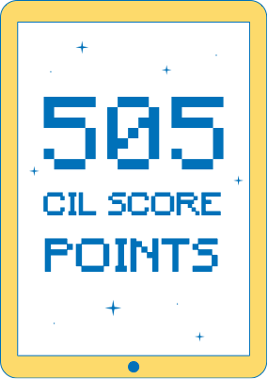

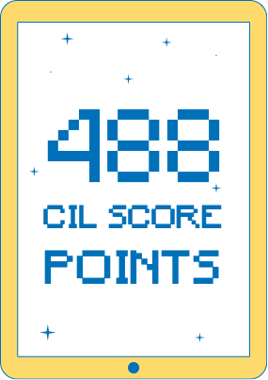
Gender differences in CIL

Slide 12

Gender differences in CIL (Female – Male)
Chile
Denmark
Finland
France
Germany
Kazakhstan
Korea, Rep. of
Luxembourg
Portugal
Uruguay
ICILS 2018 Av.
Italy
United States
Moscow (Russian Federation)
North Rhine-Westphalia (Germany)
Sig. 0.05
Not Sig. 0.05

Slide 13
Factors Associated with Student CIL
Multilevel modeling outcomes: statistically significant associations with CIL
In most countries
Female (7/11)
Test language spoken at home (6/11)
Higher expected educational attainment (10/11)
Higher SES (11/11)
Five or more years experience of using computers (11/11)
Daily computer use at home (11/11)
Two or more computers at home (6/11)
In some countries
Reports learning about CIL-related tasks at school (5/11)
Reports using basic ICT tools in class (4/11)

Slide 14
Student CT outcomes

Slide 15
Country CT Averages
Korea, Rep. of
Denmark
Finland
France
Germany
Portugal
Luxembourg
United States
North Rhine-Westphalia (Germany)

Slide 16
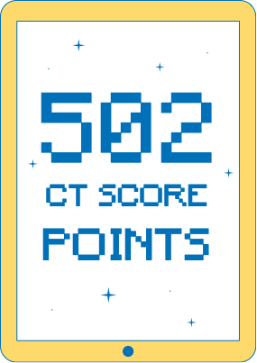
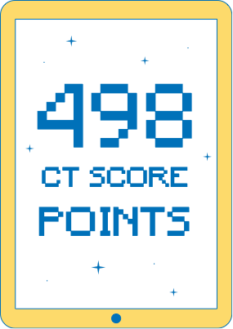
Gender differences and CT

Slide 17
Gender differences in CT
Denmark
Finland
France
Germany
Korea, Rep. of
Luxembourg
Portugal
ICILS 2018 Av.
United States
North Rhine-Westphalia (Germany)
Sig. 0.05
Not Sig. 0.05

Slide 18
Association between CIL and CT
Denmark
Finland
France
Germany
Korea, Rep. of
Luxembourg
Portugal
ICILS 2018 Av.
0.81 | (0.01)
0.89 | (0.01)
0.87 | (0.01)
0.81 | (0.01)
0.74 | (0.01)
0.80 | (0.01)
0.78 | (0.01)
0.82 | (0.00)
United States
0.82 (0.01)
North Rhine-Westphalia (Germany)
0.81 (0.01)

Slide 19
Factors Associated with Student CT
Multilevel modeling outcomes: statistically significant associations with CT
In most countries
Male (6/7)
Test language spoken at home (4/7)
Higher expected educational attainment (6/7)
Higher SES (7/7)
Five or more years experience of using computers (6/7)
Daily computer use at home (7/7)
Reports less explicit learning of CT-related content in class (7/7)
In some countries
Reports using basic ICT tools in class (3/7)
In a schools where:
  ICT coordinators reported higher resourcing (2/7)
  Principals reported teachers expected to use ICT to communicate (2/7)

Slide 20
The digital divide and student CIL and CT outcomes

Slide 21
Digital divide
12/14 participating entities indicated that reducing the digital divide between groups of students was emphasized in their plans, policies, and priorities regarding the use of ICT
SES and experience using computers were strongly associated with student CIL and CT

Slide 22
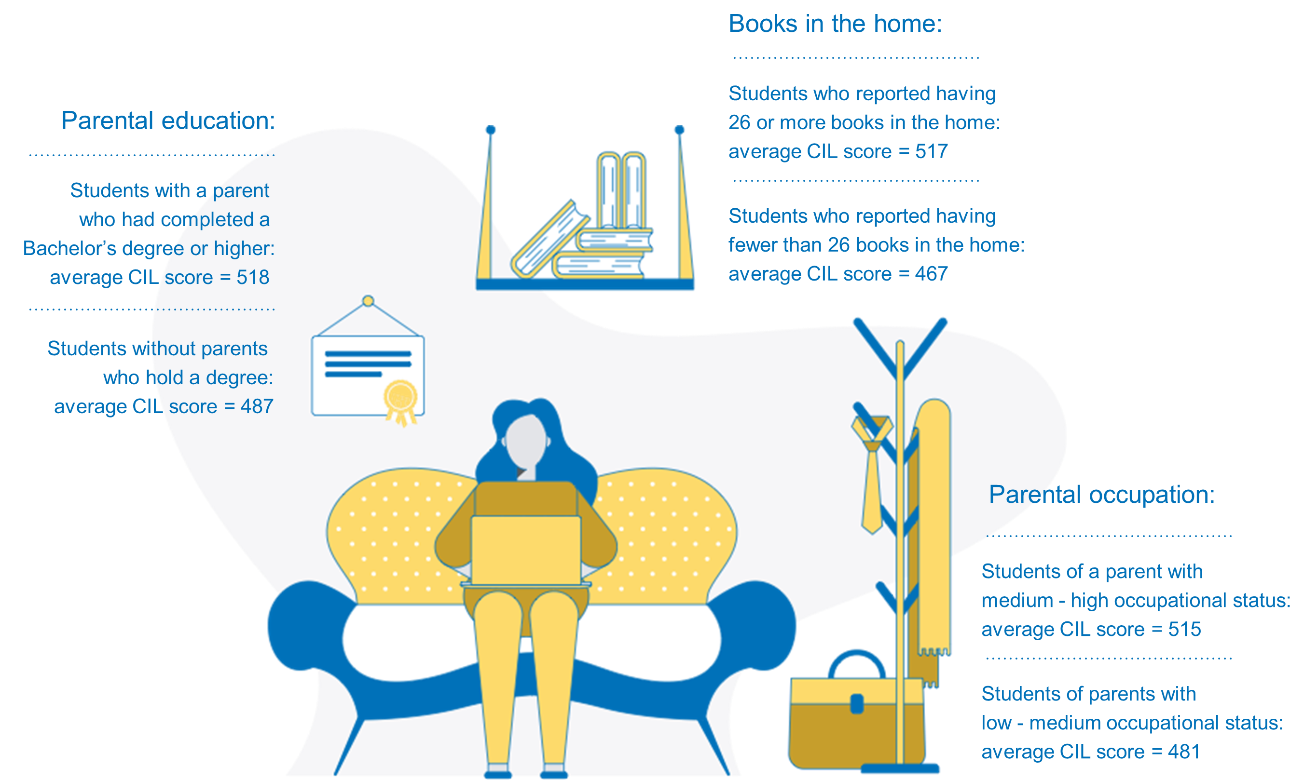
Digital divide - SES

Slide 23
Digital divide (CIL)
Highest 5% CIL
Highest 5% CIL
Highest country mean CIL
347 scale points
(Kazakhstan)
216 scale points
(Denmark)
157 scale points
Lowest country mean CIL
Lowest 5% CIL
Lowest 5% CIL

Slide 24
Digital divide (CT)
Highest 5% CT
Highest 5% CT
Highest country mean CT
371 scale points
(Korea, Rep. of)
266 scale points
(Portugal)
76 scale points
Lowest country mean CT
Lowest 5% CT
Lowest 5% CT

Slide 25
Students’ use of ICT

Slide 26
Students’ use of ICT at school and out of school
% students reporting daily use of ICT...
 | At school for school-related purposes | At school for other purposes | Outside of school for school-related purposes | Outside of school for other purposes
Chile | 12 | 27 | 14 | 62
Denmark | 81 | 55 | 35 | 79
Finland | 12 | 56 | 15 | 79
France | 8 | 13 | 25 | 76
Germany | 4 | 16 | 11 | 83
Italy | 7 | 4 | 22 | 77
Kazakhstan | 24 | 30 | 31 | 48
Korea, Rep. of | 5 | 19 | 10 | 68
Luxembourg | 18 | 33 | 27 | 66
Portugal | 7 | 36 | 10 | 71
Uruguay | 15 | 25 | 33 | 66
ICILS 2018 average | 18 | 29 | 21 | 70
United States | 43 | 28 | 29 | 66
Moscow (Russian Federation) | 22 | 43 | 40 | 77
North Rhine-Westphalia (Germany) | 3 | 19 | 9 | 85

Slide 27
Students’ use of ICT at school and out of school
% students reporting daily use of ICT...
 | At school for school-related purposes | At school for other purposes | Outside of school for school-related purposes | Outside of school for other purposes
Chile | 12 | 27 | 14 | 62
Denmark | 81 | 55 | 35 | 79
Finland | 12 | 56 | 15 | 79
France | 8 | 13 | 25 | 76
Germany | 4 | 16 | 11 | 83
Italy | 7 | 4 | 22 | 77
Kazakhstan | 24 | 30 | 31 | 48
Korea, Rep. of | 5 | 19 | 10 | 68
Luxembourg | 18 | 33 | 27 | 66
Portugal | 7 | 36 | 10 | 71
Uruguay | 15 | 25 | 33 | 66
ICILS 2018 average | 18 | 29 | 21 | 70
United States | 43 | 28 | 29 | 66
Moscow (Russian Federation) | 22 | 43 | 40 | 77
North Rhine-Westphalia (Germany) | 3 | 19 | 9 | 85

Slide 28
Students’ use of ICT at school and out of school
% students reporting daily use of ICT...
 | At school for school-related purposes | At school for other purposes | Outside of school for school-related purposes | Outside of school for other purposes
Chile | 12 | 27 | 14 | 62
Denmark | 81 | 55 | 35 | 79
Finland | 12 | 56 | 15 | 79
France | 8 | 13 | 25 | 76
Germany | 4 | 16 | 11 | 83
Italy | 7 | 4 | 22 | 77
Kazakhstan | 24 | 30 | 31 | 48
Korea, Rep. of | 5 | 19 | 10 | 68
Luxembourg | 18 | 33 | 27 | 66
Portugal | 7 | 36 | 10 | 71
Uruguay | 15 | 25 | 33 | 66
ICILS 2018 average | 18 | 29 | 21 | 70
United States | 43 | 28 | 29 | 66
Moscow (Russian Federation) | 22 | 43 | 40 | 77
North Rhine-Westphalia (Germany) | 3 | 19 | 9 | 85

Slide 29
Students’ use of ICT at school and out of school
% students reporting daily use of ICT...
 | At school for school-related purposes | At school for other purposes | Outside of school for school-related purposes | Outside of school for other purposes
Chile | 12 | 27 | 14 | 62
Denmark | 81 | 55 | 35 | 79
Finland | 12 | 56 | 15 | 79
France | 8 | 13 | 25 | 76
Germany | 4 | 16 | 11 | 83
Italy | 7 | 4 | 22 | 77
Kazakhstan | 24 | 30 | 31 | 48
Korea, Rep. of | 5 | 19 | 10 | 68
Luxembourg | 18 | 33 | 27 | 66
Portugal | 7 | 36 | 10 | 71
Uruguay | 15 | 25 | 33 | 66
ICILS 2018 average | 18 | 29 | 21 | 70
United States | 43 | 28 | 29 | 66
Moscow (Russian Federation) | 22 | 43 | 40 | 77
North Rhine-Westphalia (Germany) | 3 | 19 | 9 | 85

Slide 30
Students’ use of ICT in lessons
(% students reporting using at least once a week during lessons)
Chile
Denmark
Finland
France
Germany
Italy
Kazakhstan
Korea, Rep. of
Luxembourg
Portugal
Uruguay
ICILS 2018 average
United States
Moscow (Russian Federation)
North Rhine-Westphalia (Germany)
Most frequent

Slide 31
Students’ use of ICT in lessons
(% students reporting using at least once a week during lessons)
Chile
Denmark
Finland
France
Germany
Italy
Kazakhstan
Korea, Rep. of
Luxembourg
Portugal
Uruguay
ICILS 2018 average
United States
Moscow (Russian Federation)
North Rhine-Westphalia (Germany)

Slide 32
Teachers’ use of ICT

Slide 33
Teachers’ use of ICT in Class
(% teachers reporting use of ICT in most lessons for…)
Chile
Denmark
Finland
Italy
Kazakhstan
Korea, Rep. of
Portugal
ICILS 2018 Average
France
Germany
Luxembourg
United States
Uruguay
Moscow (Russian Federation)
North Rhine-Westphalia (Germany)
Most frequent

Slide 34
Teachers’ use of ICT in Class
(% teachers reporting use of ICT in most lessons for…)
Chile
Denmark
Finland
Italy
Kazakhstan
Korea, Rep. of
Portugal
ICILS 2018 Average
France
Germany
Luxembourg
United States
Uruguay
Moscow (Russian Federation)
North Rhine-Westphalia (Germany)
Least frequent

Slide 35
Teachers’ use of ICT in Class
Tools used by teachers in most, almost or every lesson with reference class
Software tool | Mean(%) | Min (%) | Max (%)
Word-processor software | 43 | 23 | 67
Presentation software | 43 | 20 | 67
Computer-based information resources | 36 | 30 | 46
Digital contents linked with textbooks | 32 | 16 | 48

Slide 36
Teachers’ use of ICT in Class
Tools used by teachers in most, almost or every lesson with reference class
Software tool | Mean(%) | Min (%) | Max (%)
Word-processor software | 43 | 23 | 67
Presentation software | 43 | 20 | 67
Computer-based information resources | 36 | 30 | 46
Digital contents linked with textbooks | 32 | 16 | 48
Graphing or drawing software | 10 | 3 | 30
e-portfolios | 7 | 1 | 21
Concept mapping software | 7 | 1 | 19
Simulations and modelling software | 5 | 1 | 18

Slide 37
Teachers’ use of ICT in Class
Tools used by teachers in most, almost or every lesson with reference class
Software tool | Mean(%) | Min (%) | Max (%)
Word-processor software | 43 | 23 | 67
Presentation software | 43 | 20 | 67
Computer-based information resources | 36 | 30 | 46
Digital contents linked with textbooks | 32 | 16 | 48
A learning management system | 28 | 3 | 73
Communication software | 22 | 10 | 45
Interactive digital learning resources | 22 | 6 | 49
Spreadsheets | 17 | 4 | 46
Collaborative software | 17 | 5 | 39
Video and photo software for capture and editing | 15 | 5 | 35
Social media | 12 | 3 | 38
Digital learning games | 12 | 5 | 36
Practice programs or apps | 11 | 5 | 20
Graphing or drawing software | 10 | 3 | 30
e-portfolios | 7 | 1 | 21
Concept mapping software | 7 | 1 | 19
Simulations and modelling software | 5 | 1 | 18

Slide 38
Teacher use of and confidence to use ICT
Teachers who use ICT daily compared to those who do not
    Have higher ICT-self efficacy
    Are more positive about the use of ICT in teaching and learning
    Hold less negative beliefs about the potential problems associated with the use of ICT in teaching and learning
Across countries teachers expressed confidence to complete a broad range of ICT tasks but:
  Younger teachers (<40 years) are more confident than older teachers (0.4 sd on average across all countries)

Slide 39
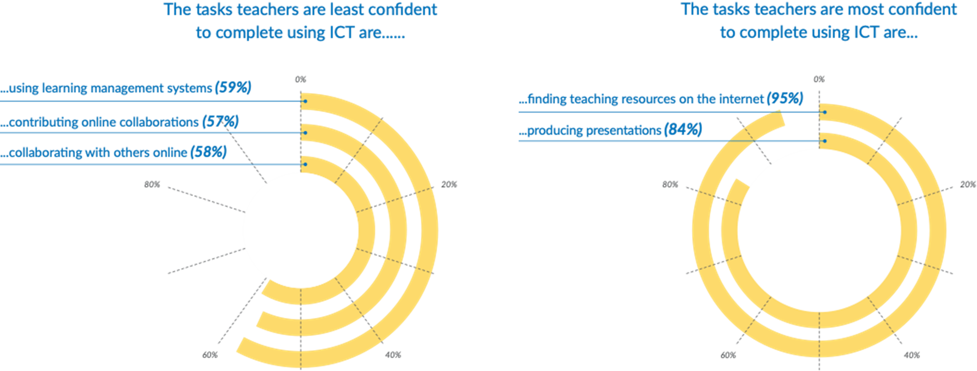
Teacher confidence to use ICT

Slide 40
Teacher confidence to use ICT
Across countries teachers expressed confidence to complete a broad range of ICT tasks but:
  Younger teachers (<40 years) are more confident than older teachers (0.4 sd on average across all countries)

Slide 41

CIL and CT teaching
CIL and CT
learning

Slide 42
Factors associated with teachers’ likelihood to emphasize CIL or CT in their teaching
 | Emphasis on teaching CIL |  | Emphasis on teaching CT
 | ICILS 2018 Average* | Significant (# countries) | ICILS 2018 Average* | Significant (# countries)
ICT self-efficacy | 1.9 | 9/9 | 1.3 | 9/9
Positive views on ICT | 1.8 | 9/9 | 1.1 | 9/9
Collaborative school environment | 2.1 | 9/9 | 2.1 | 9/9
Availability of school ICT resources | 0.5 | 2/9 | 0.4 | 3/9
Years experience using ICT during lessons | 1.0 | 9/9 | 0.4 | 5/9
Variance explained | 27% | - | 16% | -
*Changes in teacher emphasis scores corresponding to an increase in one (national) standard deviation in each of the predictor variables.

Slide 43
Brief reflections

Slide 44
Brief reflections
ICILS continues to be a pioneering study
  First and only cross-national ILSA to measure directly and describe achievement in
    Digital literacy (through CIL)
    Computational thinking
Evidence of the digital divide but not of the digital natives
What is best practice teaching with ICT?
  Is using ICT mainly as digital textbooks sufficient?
Support to teachers to work with ICT may include
  increasing teacher expertise in ICT use
  implementing collaborative environments in schools
  addressing the specific needs of older (>40 years) teachers (as a target sub-group)

Slide 45
Computational thinking – beating the test

Slide 46
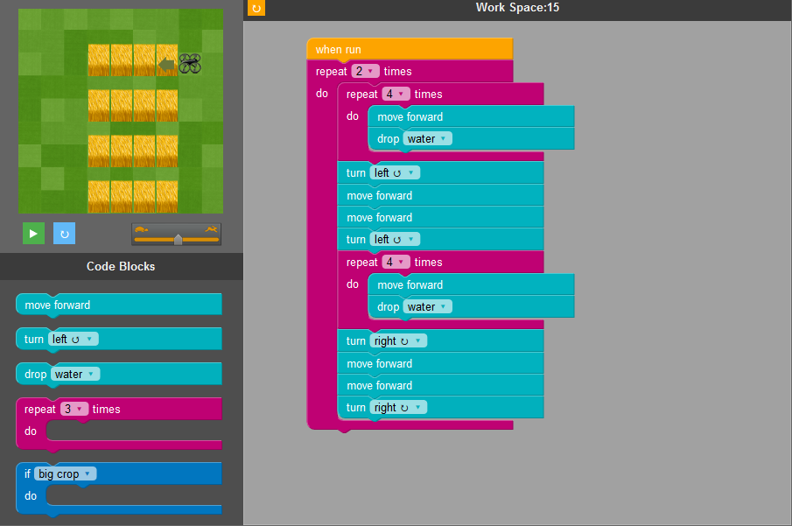
Computational thinking – beating the test!

Slide 47
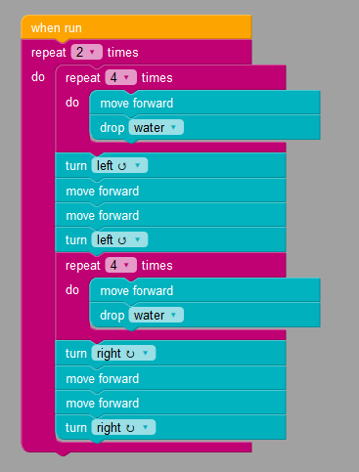
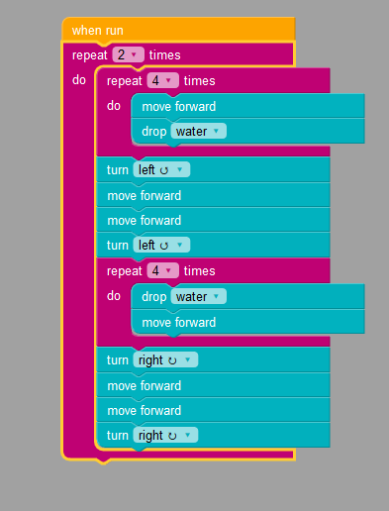
Computational thinking – beating the test!

Slide 48
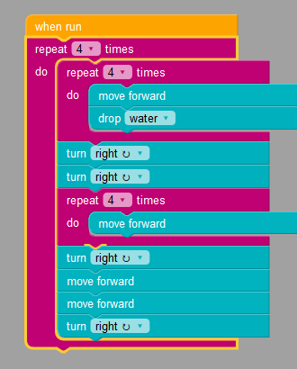
Computational thinking – beating the test!
12 code block solution
5 students (from 5 different countries)
  A further 3 created a 13 code block solution
  A further 3 created a 14 code block solution

Slide 49
Thank You
Questions
Julian.Fraillon@acer.org
icils@acer.org

